Slide 1
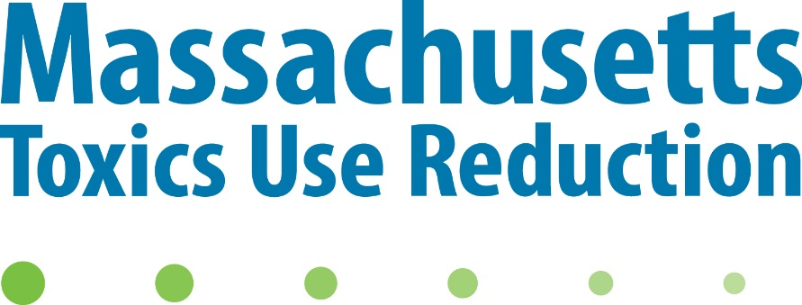
TURA Program Update
SAB and TURA Ad Hoc Committee
Virtual Meetings
Nov 2020

Slide 2
TURA Administrative Council
Addition of TRI NDAA PFAS chemicals
172 PFAS chemicals added to TRI for 2020 reporting year, as required in the NDAA 2020 legislation
14 specific long-chain and GenX PFAS, plus 158 precursor PFAS
Individually listed with 100 lb reporting threshold
Nov 20, 2020 Public Hearing on draft regulations, 1-3PM
Not reportable under TURA for 2020 reporting year
Notes:
See handout for link to EPA list of chemicals
Public hearing on Friday afternoon 1PM

Slide 3
TURA Ad-Hoc Committee on TURA Improvement
The Administrative Council has designated an ad hoc committee to review experiences since the 2006 TURA Amendments
Looking forward to the next decade and the critical priorities of Massachusetts with respect to toxic chemicals and safer materials.
Notes:
Objective: The Administrative Council has created an ad hoc committee to review experiences in the 10+ years since the 2006 TURA Amendments, and look forward to the next decade and the critical priorities of Massachusetts with respect to toxic chemicals and safer materials.
The objective of the TURA Program Strengthening AHC is to review and strengthen the effectiveness and value of TURA program activities and requirements to Massachusetts businesses while ensuring ongoing progress in reducing the use of toxics in the Commonwealth and increasing the adoption of safer materials.

Slide 4
TURA Ad-Hoc Subcommittee on TURA Improvement
Upcoming Virtual Meeting - Orientation
Nov 19, 2020 3-5PM
Subsequent meeting topics
Compliance and Enforcement
Resource Conservation Planning
TUR Planners
Toxic or Hazardous Substance List
Fees
Notes:
Tomorrow – 3-5PM, orientation will be recorded as well
C&E – level playing field, DEP has begun calling in some plans and reviewing them, use this to improve productive of planning and improve targeting of program services and education
RC planning – 2006 amendments introduced option for companies that weren’t getting return from TUR planning every 2 yrs, but hasn’t been used as much as anticipated. how do we increase participation in this option and increase productivity of planning process?
TUR planners – backbone of effective TUR planning – QC, Continuing ed, RC certification
Chemical list, 2006 amendments provided for HHS, LHS, and changed the priority user segments provision. How has this worked so far? How do we maintain current and relevant chemical list going forward?
Fees – provision in 2006 amendments for council to review, a proposal was made, but never acted on; the fees haven’t changed in 30 yrs,

Slide 5
Science Advisory Board
Quaternary ammonium compounds
Nanomaterials – petition to list carbon nanotubes and carbon nanofibers
Notes:
(SAB met yesterday, Nov 18)
SAB begun work on 2 categories of chemicals.
Quats used in many disinfectant products – because of the pandemic and the rapid rise in use of these and other disinfectants, concerned with health and environmental effects. For example, the SAB is looking at asthma and respiratory issues, among other endpoints. Focus is on the alkyl and benzyl quats used in disinfectants. More info on SAB website
Program Rec’d petition (CWA and PEER) to list CNTs and CNFs – SAB beginning by having some experts present to them while they are deliberating on quats, then will begin deliberations on nanomaterials.
Call for information on both out now – contact Heather Tenney if you have questions or would like to offer information

Slide 6
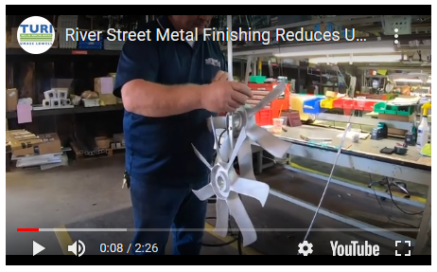
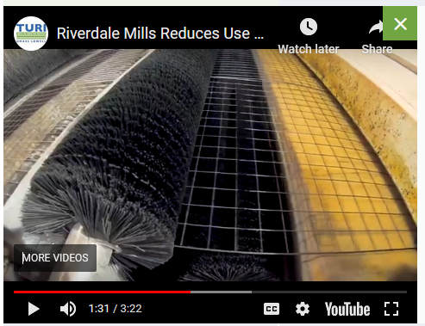
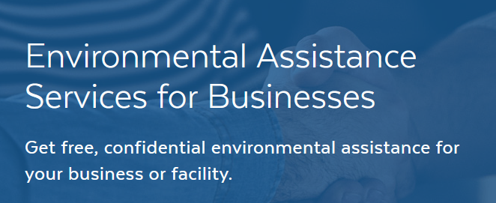
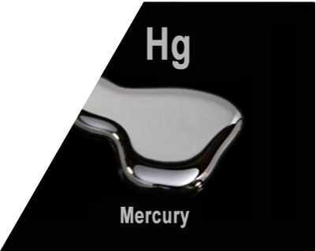
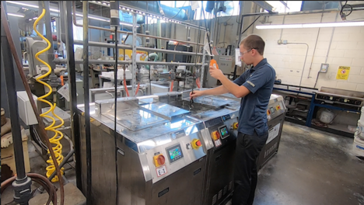
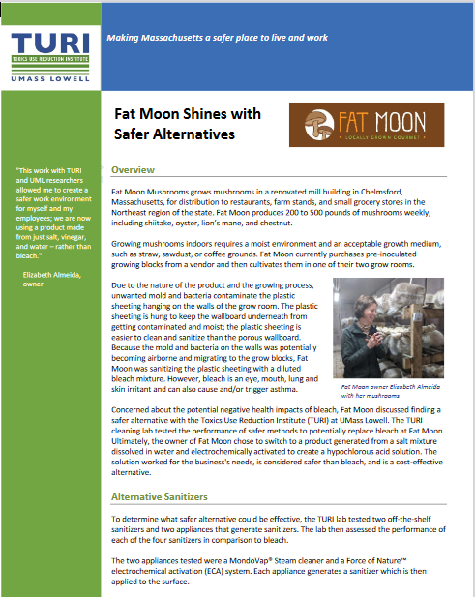
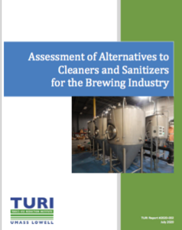
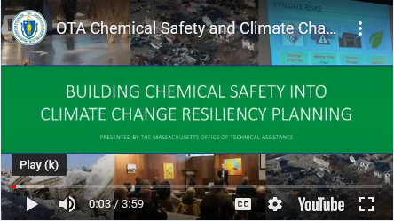
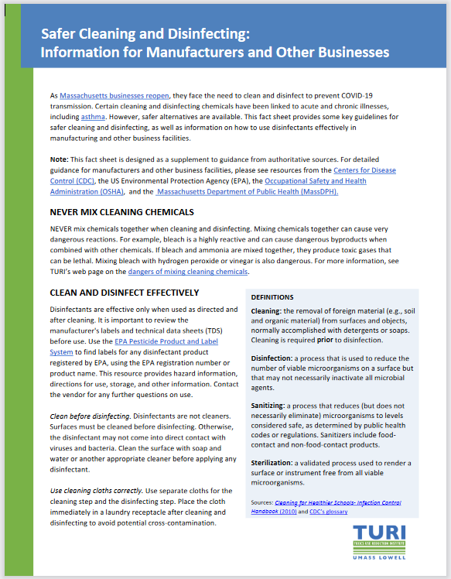
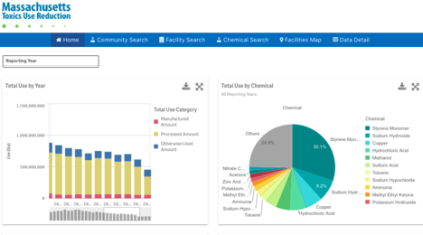
TURA Program Resources
Videos, demo sites, case studies
See written program update posted with conference materials
Cleaning and Disinfecting information
Notes:
Pandemic, but there has been a lot going on in TURA program!
Refer to written program update for lots of links to videos, case studies, recorded demo site events and other information.
Few highlights – demo sites at Morgan Adv Mat’ls, aqueous cleaning system in place of TCE, River street metal finishing and Riverdale Mills reducing use of acids and bases,
Several new case studies from food and beverage on cleaning and sanitization, safer solvents and newer info on heat hazards and artificial turf.
If you aren’t signed up for this afternoon’s session, go take a look at the new TURA Data site on TURI’s website.
Same w/ C&D, in addition to this mornings session, look at TURI’s website. Asthma fact sheet in English and Portuguese, info about safer ways to protect your employees from the virus
OTA’s info on how TUR helps w/ climate resiliency

Slide 7
TURI Grant Projects – FY 2021 Safer Solvents
Steel Art Company, Norwood
Safer substitute for n propyl bromide
Grove Hall Cleaners, Dorchester
Professional wet cleaning
Asst. Prof. Chen, UMass Lowell Plastics Engineering, partnering with Johnson Matthey
Safer substitute for methylene chlorine in pharmaceuticals
Notes:
FY21 grants – some looking at safer substitutes for toxic solvents, some aqueous formulations, some safer solvents.
- Industrial parts cleaning, garment cleaning, and pharmaceutical mfr

Slide 8
TURI Grant Projects – FY 2021 Safer cleaning and disinfection
Family Martial Arts Center, Leominster, Fitchburg
Clean Water Fund, with MassCOSH, Resilient Sisterhood Project, Vida Verde Women’s Co-op, and AFT-Massachusetts
Brazilian Women’s Group
Informed Green Solutions
Silent Spring Institute, with Resilient Sisterhood Project
+ product choices for women of color
Notes:
Due to the pandemic, have several grants focused on safer cleaning and disinfecting
You heard info this morning, these organizations are doing a variety of things to help get the information out
from developing resource materials for schools,
educating janitorial workers, teachers, and the public,
To piloting some innovative devices
In addition to cleaning, the Silent Spring project is working with women of color to provide info on safer product choices.
A lot of partnerships, to spread word as far as possible

Slide 9
TURI Grant Projects – FY 2021 Food Systems and Processing
Wellspring Harvest Corporation, Springfield
Eliminating pesticides with tighter process and humidity control
EPA Healthy Communities grant
TURI obtained an EPA grant for Lean manufacturing for food processors in the Merrimack Valley
Notes:
In Food and beverage sector,
TURI has given a grant to Wellspring Harvest in Springfield to control powdery mildew with better process control instead of pesticides, and
Also obtained grant from EPA to work w/ food processors to integrate lean mfr in Merrimack valley. That provides Lean training; If you are or know of co. that would be interested in participating, contact Joy Onasch at TURI.

Slide 10
OTA Virtual Site Visits
Chemists and Engineers available by:
Virtual Zoom site visits
Phone
Email
Forms of Assistance:
Toxics Use Reduction
Regulatory and Compliance
Resource conservation
Pollution prevention
Identifying PFAS products
Notes:
Turn it back to Tiffany to wrap us up

Slide 11
Contact us any time!
TURI questions:
Liz Harriman harriman@turi.org
TURI Staff: https://www.turi.org/About/Staff_List
OTA questions:
Tiffany Skogstrom Tiffany.skogstrom@mass.gov
OTA Staff: https://www.mass.gov/service-details/otas-team
MassDEP questions:
Planning: Lynn Heisey Cain lynn.cain@mass.gov
Reporting: Walter Hope walter.hope@mass.gov
C&E: Veronica Wancho O'Donnell veronica.odonnell@state.ma.us

